Slide 1
Summarization Prompt Development and Evaluation
Internship Learnings and Contributions
August 31, 2023
By Ritvik Khandelwal, Data Science Health Intern
Supervisor: Dr. Drahomira Herrmannova, NLP & Data Science Manager

Slide 2
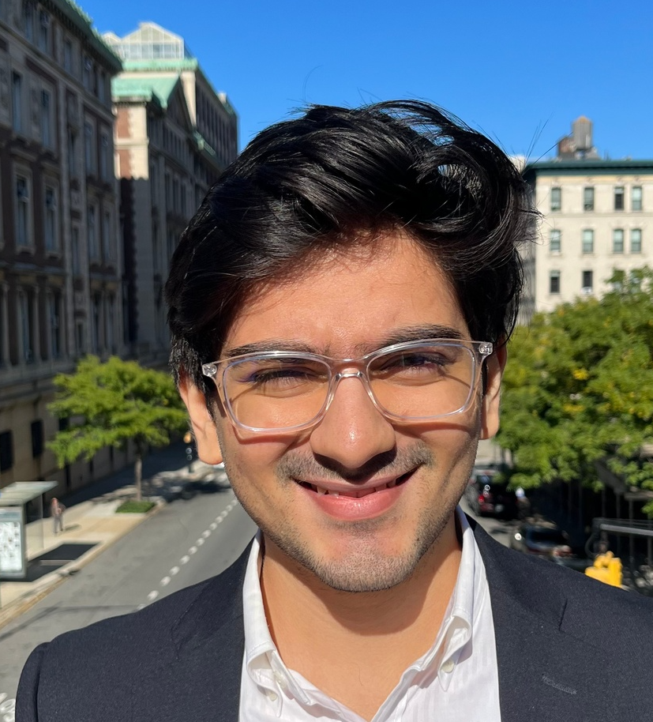



About me
Uni of Mum (2018-2022)
Research intern @ UCL
Research intern @ Uni of Mumbai
Columbia (2022 – Dec 2023)
Research scholar @ CUIMC
Healthcare
Elsevier (May 15 – Sept 1)
DS - HCO
LLMs

Slide 3
Contents
Overview of Contributions
Approach
Prompt Development
Evaluation Metrics
List of experiments
Observations and Results
Limitations
Impact and Conclusion
Future work

Slide 4

Overview of contributions
Reviewing External Content Inventory
Sampling techniques for relation extraction project
Training and testing models for summarization on Osmosis and TREC
Summarization Prompt development, engineering and evaluation
Prompt development for Named entity recognition (K minor gold dataset)
RAIDS
Reviewing important datasets for project Hawaii
Development of AIR tool
Researching about quantitative metrics to gauge bias, toxicity and representativeness

Slide 5
Motivation and overview
What are the different ways to develop prompt templates and what would be the best approach going about it?
How do I tell if the prompt templates that I am making is effective/good/bad?
How good is Vicuna for summarization? Can be extended to any LLM
Which evaluation metrics should be used and what would be the best one?
Vicuna vs other Transformer models-which is better?
How do minor changes in prompts impact the model output?
Is prompt evaluation data agnostic?

Slide 6
Data
Osmosis Video transcripts (Primary)
62 transcripts
1430 tokens on average in transcripts
106 tokens on average in summaries
TREC 2016,17 (Secondary)
60 transcripts
112 tokens on average in clinical notes
33 tokens on average in summaries
Clinical Note: A 65 yo male with no significant history of cardiovascular disease presents to the emergency room with acute onset of shortness of breath, tachypnea, and left-sided chest pain that worsens with inspiration. Of note, he underwent a right total hip replacement two weeks prior to presentation and was unable to begin physical therapy and rehabilitation for several days following the surgery due to poor pain management. Relevant physical exam findings include a respiratory rate of 35 and right calf pain. Reference Summary: A 65-year-old male presents with dyspnea, tachypnea, chest pain on inspiration, and swelling and pain in the right calf.
Reference summary: A 65-year-old male presents with dyspnea, tachypnea, chest pain on inspiration, and swelling and pain in the right calf.

Slide 7
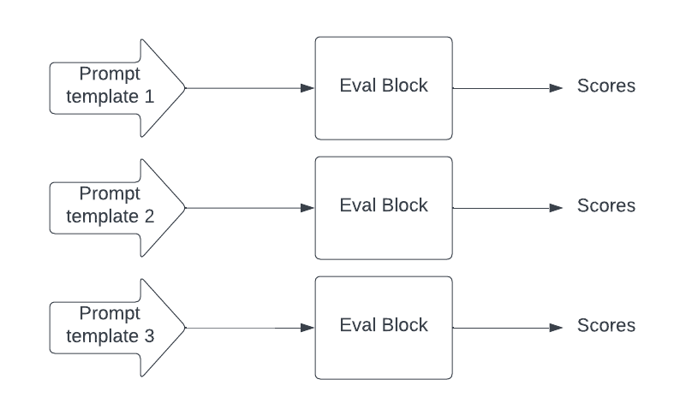
Approach

Slide 8
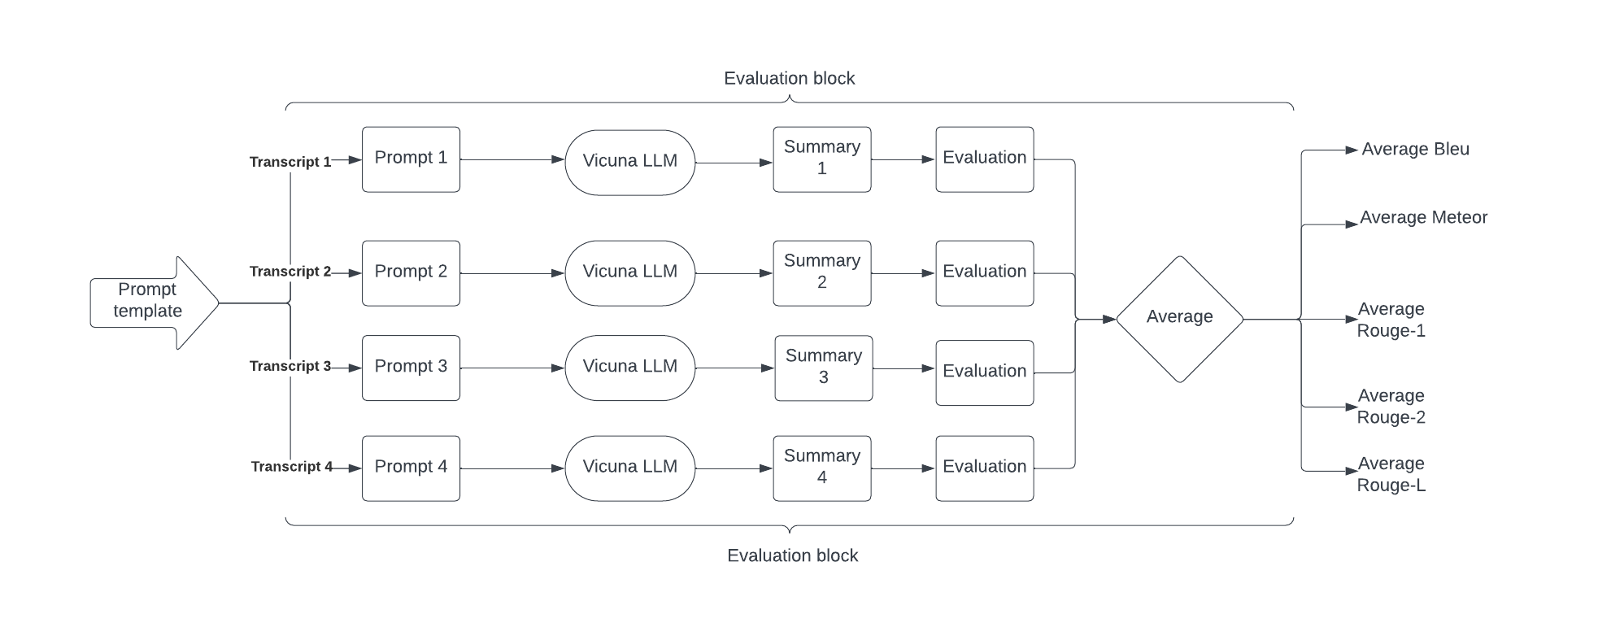
Approach

Slide 9
Evaluation Metrics
BLEU (higher the better)
Number of matching words between generated and reference summaries.
Precision of several different n-grams and averages the result.
Does not incorporate semantics, meanings and not good with order
Example – reference sentence: The weather is pleasant today,
GT – (1) The climate is agreeable today (2) The weather is nice today (3)The atmosphere is pleasant today
METEOR (higher the better)
Combines precision, recall and alignment-based measures by considering synonyms and stemming variations.
Incorporates meaning, synonym information and word order
ROUGE (higher the better)
ROUGE-1 – based on unigram precision and recall to measure summarization quality.
ROUGE-2 – based on bigram precision and recall to measure summarization quality.
ROUGE-L – does not look for n-grams. Seeks longest common subsequence.

Slide 10
Quick Recap
We have a dataset in hand (2 datasets).
We have a language model
We have a framework to evaluate the prompts along with the evaluation metrics
What next?
Now how do we create prompt templates for summarization?
Summarize the text
Give me a rough outline
Provide a brief overview
Please give me the summary in few words
Now paraphrase
Why is the above approach wrong?
Highly random,
No structure to it
Blind paraphrasing without putting much thought to it

Slide 11
Prompt Development
Randomized Prompt Template Development
Quick
Blind paraphrasing
Less variation thus potentially biased
Loss of explainability (Anti RAIDs)
Organized Prompt Template Development
Categories of prompting styles
Time consuming
Covers more variation
Enhanced explainability (Pro RAIDs)

Slide 12
Prompt Development
0 shot (no example), 1 shot (1 example), 2 shot (2 examples)
Chain of thought
With instruction/without instruction

Slide 13
Prompt Development
Persona
Direct
Indirect
You are a clinical specialist who summarizes any text given to you. This is the text: {transcript} response: {summary}
A chat between a curious user and a clinical specialist. The clinical specialist gives concise answers to the user's questions. USER: {transcript} summarize the above text Clinical Specialist: response: {summary}

Slide 14
Prompt Development – Chain of thought
Below is an example showing a text and it's summary. Observe how the summary of the text is capturing all the important clinical terms and summarizing it in a very concise manner. In a similar manner generate the summary of the text given after the example.
Text: {transcript} summary: {summary}
Text: {transcript} summary: response: {summary}
Below is an example showing a text and it's summary.
Text: {transcript} summary: {summary}
Observe how the summary of the text is capturing all the important clinical terms and summarizing it in a very concise manner. In a similar manner generate the summary of the text given after the example.
Text: {transcript} summary: response: {summary}
Indirect

Slide 15
Prompt Development
Hallucination specific prompts
{transcript} Generate a summary for the above text using only the information given in the text. Response: {summary}
{transcript} Summarize the above text as a medical professional. The summary should only use the information given in the text Response: {summary}
{transcript} As a medical professional, summarize the above text. The summary should only use the information given in the text and it should be objective, unbiased and factual Response: {summary}

Slide 16
List of Experiments
0 shot
without persona
with direct persona
with indirect persona
with chain of thought
1 shot
without persona (w/wo instruction possible)
with direct persona
with indirect persona
with chain of thought (w/wo persona possible)
2 shot
without persona (w/wo instruction possible)
with direct persona ----
with indirect persona ----
with chain of thought
Hallucination specific prompts

Slide 17
Observations
Metric focussed observations
Metrics are relatively consistent. Same trend not observed for transformer models
example – METEOR(P1) > METEOR(P2) => BLEU (P1)>BLEU(P2) & ROUGE (P1)>ROUGE(P2)
BLEU (0.01- 0.03), METEOR (0.1 – 0.35), ROUGE (similar to ROUGE)
Concluded METEOR as the best metric - Reason on confluence
Observations within prompt categories
Persona of medical professional > persona of clinical specialist
Relative position of the transcript and instruction in the input plays a major role
Chain of thought added after examples gives a better result instead of before
Adding/removing instruction makes negligible difference (1 shot, 2 shot, osmosis, trec)

Slide 18
Observations and Results
Instruction before input
Instruction after input
summarizie this: {transcript} Response: {summary}
{transcript} summarize the above text Response: {summary}
summarize the text below {transcript} response: {summary}
{transcript} give me a rough outline of the above text response: {summary}
You are a clinical specialist who summarizes any text given to you. This is the text: {transcript} response: {summary}

Slide 19
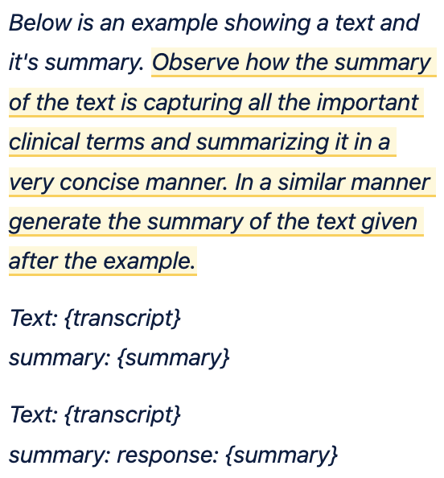
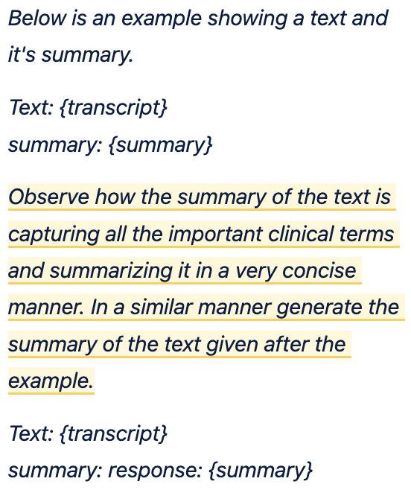
Observations and Results
Chain of thought after example
Chain of thought before example

Slide 20
Results
 | Zero-shot | One-shot | Two-shot
Without persona | 0.2847 | 0.2418 | 0.2659, 0.2664
Direct persona | 0.2766 | Future work | Future work
Indirect persona | 0.3284 | Future work | Future work
COT | 0.3054 | 0.26851 | 0.2868
Hallucination specific | 0.28805 | 0.2797 | 0.303
Notes:
Presenter: AR

Slide 21
Observations
Observations between different prompt categories
Best prompt – 0 shot with indirect persona
Paraphrased versions under each categories gave similar types of results
Chain of thought not good enough probably because of poor quality
In general, 0 shot > 2 shot > 1 shot
Miscellaneous Observations
Prompt performance is data agnostic (language model is constant)
If P1>P2 (Osmosis) => P1>P2 (TREC)
Vicuna suffers with high degree of hallucinations in general, not good with few shot
Vicuna > Transformers
Vicuna is able to handle high token length prompts, GPT cannot.

Slide 22
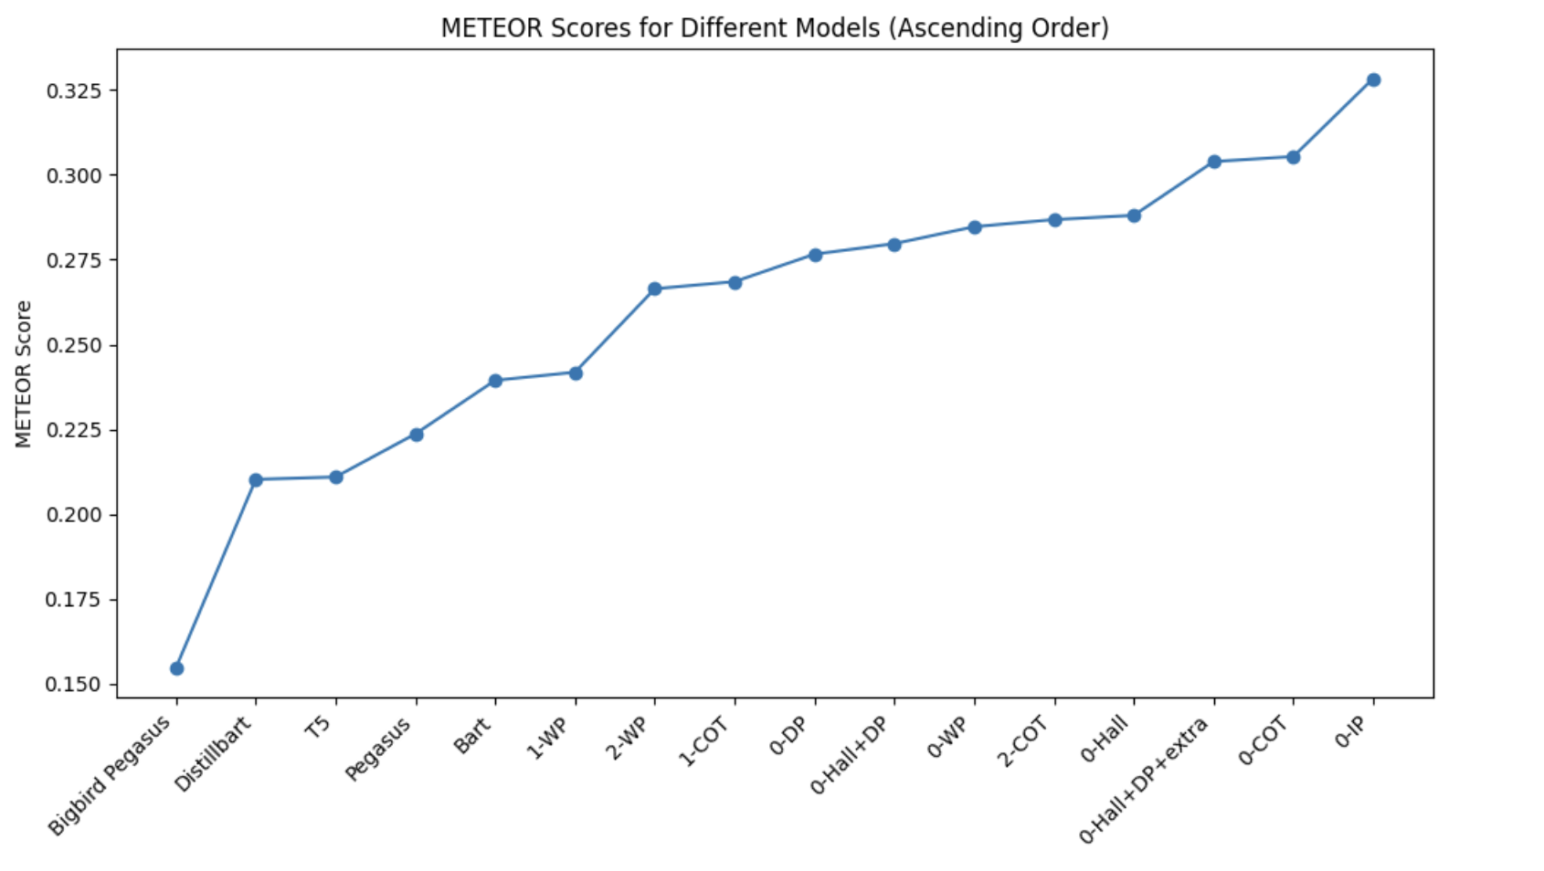
Vicuna vs Transformers
Notes:
Presenter: AR

Slide 23
Limitations
Organized prompt development is very time consuming
Only 62 transcripts included in this study
Evaluating each prompt on 62 transcripts took around 30 minutes
Let’s say 50 transcripts in 1 prompt = 30 minutes => 1000 transcripts ~ 10 hours
Therefore 30 prompts = 12.5 days
Arguable that organized prompt development could lead to bias
Solution – Combining random + organized, making sure all categories are equally represented
Focusing only on quantitative evaluations
Solution – Automate qualitative evaluations with SME help
Chain of thought of prompt used here is very generic
Need to come up with a better rationale and data specific prompt with SMEs

Slide 24
Impact and Conclusions
Proposed a framework for organized prompt development, potentially allowing the LLM to adapt better to different prompting styles.
Resulted in enhanced prompt development
Framework evaluates LLM and prompts simultaneously
Prompts are evaluated directly.
Rank LLMs based on their overall performances across all the prompts.
Consistently identify top performing prompts which can be shared with end users.
Enhanced explainability aligning with the RAIDs principles.
Documented a possibly novel approach where prompt engineering is being used to train a model

Slide 25
Future Work / Points of Discussion
Use the framework to evaluate other LLMs and prompts and see if the observations generalize
As compute power becomes accessible, in-house LLM training will become the norm.
Take SME help to check for correlations between quantitative and qualitative evaluations.
Potentially create a tool and make a prompt evaluation benchmark system.
Post processing scripts to find out the trends in the outputs generated for each prompt

Slide 26

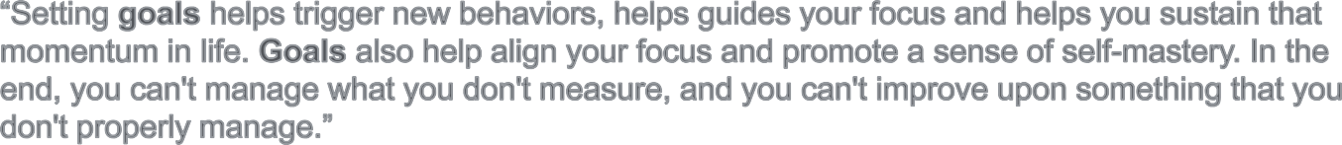

Thank you so much!

Slide 27
Points of Discussion
In papers where instruction tuning is done, do they reveal the exact instructions or what type of instructions they are tuning on? The reason I ask this is because traditionally the entire idea of prompt engineering is to develop prompts to get the best out of the model. That is how you get these different prompting techniques. But what if you instruction tune models on these very prompting techniques. Has this been done before or documented?
(qualitative evaluation ideas) Post processing scripts can be developed which can find out trends in the output generated across all the prompts. With initial SME help, we can find patterns and potentially even automate qualitative evaluations. For example, SME gives a score for each summaries generated and then we can analyze these generated summaries to find common trends which correlate with a high score. These observed trends can be recorded to now identify new summaries with high qualitative score
How to gauge how good an LLM is? What are LLMs generally evaluated on? Is evaluation done capability wise (like different evaluations for summarization, NER, etc) The reason I ask this is because how about developing a certain set of prompts for a specific capability and then prompting all the LLMs with the same set of prompts. We can then see which LLM had the highest scores across all the prompts. Thus we can potentially rank LLMs this way.

